Slide 1
Week 3
邱弘毅 卓泉源

Slide 2
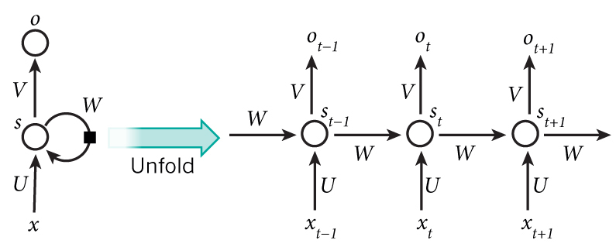
RNN

Slide 3
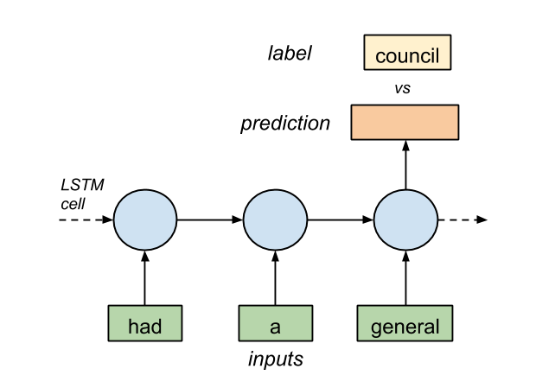
Task

Slide 4
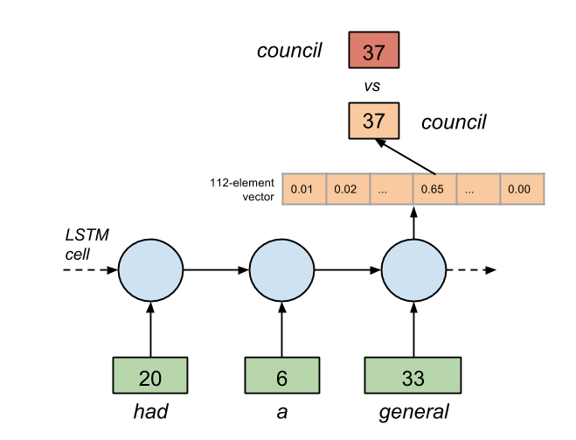

Slide 5
Detail
Optimizer: RMSProp
Loss: softmax + cross entropy (tf.nn.softmax_cross_entropy_with_logits)
Rnn: BasicLSTMCell

